Slide 1
Data cleaning, transformation and integration
Stephen F Elston | Principle Consultant , Quantia Analytics, LLC

Slide 2
Chapter Overview
Missing values
Outliers and errors
Scaling
Filtering with custom code

Slide 3
Data Cleaning and Transformation Overview (data munging)
Data rarely arrives in the form needed for analysis
Data munging is typically the most time consuming part of a data science project
Is an iterative process
Often discovered with visualization
Fix modeling problems

Slide 4
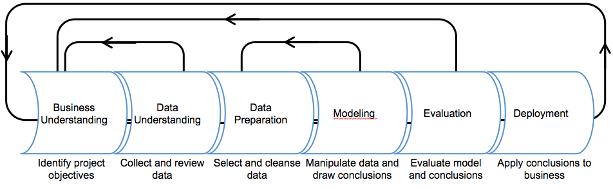
Data Cleaning and Transformation Process
Iterative process

Slide 5
Chapter 12 Missing and repeated values
Stephen F Elston | Principle Consultant , Quantia Analytics, LLC

Slide 6
Missing and Repeated Values
Missing values and repeated values are common
Many ML algorithms don’t deal with missing values
Repeated values bias results

Slide 7
Missing Values
Col1 | Col2 | Col3 | Col4 | Col5
12456 | 0.99 | Male | 43 | Small
98567 | 1.23 |  | 55 | Medium
34567 | 9999 | Female | NA | Large
67231 | 0.72 | Male | 35 | ?

Slide 8
Treating Missing Values
Remove rows
Substitute a specific value
Interpolate values
Forward fill
Backward fill
Impute

Slide 9
Clean Missing and Repeated Values
Clean Missing Data module
With R – is.na()
With Python – pandas.isnull()

Slide 10
Repeated Values
Key Col | Col2 | Col3 | Col4 | Col5
12456 | 0.99 | Male | 43 | Small
98567 | 1.23 | Male | 55 | Medium
34567 | 1.55 | Female | 43 | Large
34567 | 1.55 | Female | 43 | Large
34567 | 1.55 | Female | 43 | Large
34567 | .78 | Male | 43 | Large
67231 | 0.72 | Male | 35 | Small

Slide 11
Clean Missing and Repeated Values
Clean Repeated Values module
With R –duplicated()
With Python – DataFrame.drop_duplicates()

Slide 12
Cleaning outliers and errors

Slide 13
Outliers and Errors
Errors and outliers can bias model training
Many possible sources of errors
Erroneous measurements
Entry errors
Transposed values in table
Discover and evaluate with summary statistics and visualization

Slide 14
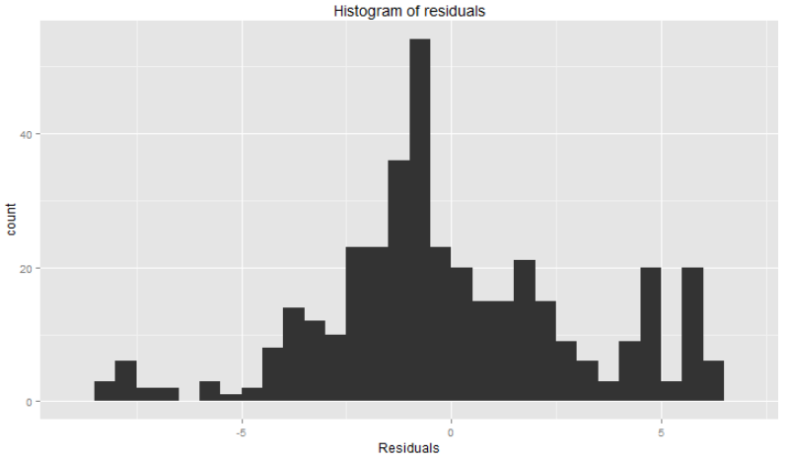
Identify Outliers and Errors
Outliers?

Slide 15
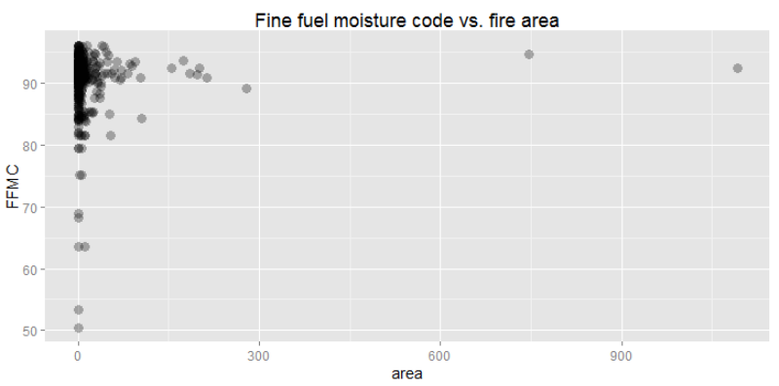
Identify Outliers and Errors
Outliers?

Slide 16
Clean Outliers and Errors
Error treatments
Censor
Trim
Interpolate
Substitute
Clip Values module
With R
With Python

Slide 17
Visualizing Outliers
Scatter plot matrix helps validate outliers
R – pairs plot
Python – pandas.tools.plotting.scatter_matrix

Slide 18
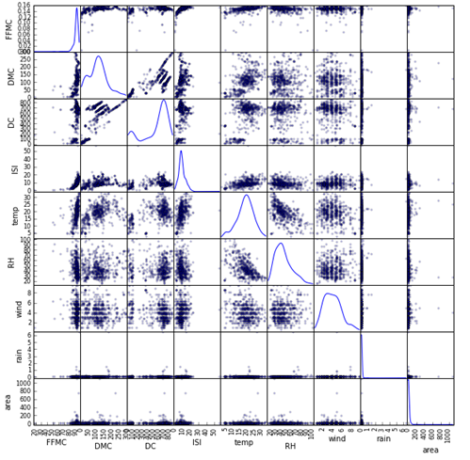
Visualizing Outliers

Slide 19
Removing Outliers
R: data.frame = data.frame[filter.expression, ]
library(dplyr)
frame1 <- frame1 %>% filter(FFMC > 40) %>%
filter(ISI < 30) %>%
filter(rain < 3)
Python: DataFrame = DataFrame[filter_expression]
frame1 = frame1[(frame1["FFMC"] > 40.0) &
(frame1["ISI"] < 30.0) &
(frame1["rain"] < 3.0)]

Slide 20
Summary
Missing values
Outliers and errors
Scaling

Slide 21
Scaling Data

Slide 22
Scaling
Numeric variables need similar scale
Often scale to zero mean and unit variance
May need to de-trend
Other scaling includes min-max
Scale after treating outliers

Slide 23
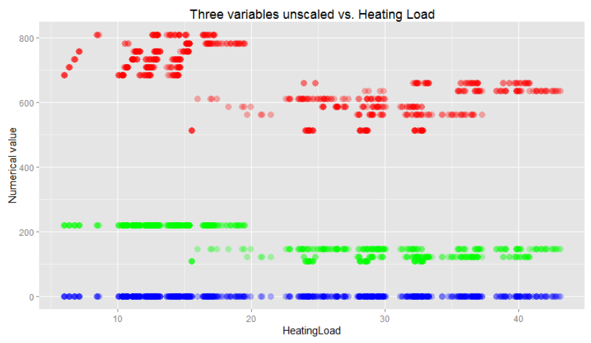
Unscaled data biases model construction
RelativeCompactness
SurfaceArea
RoofArea

Slide 24
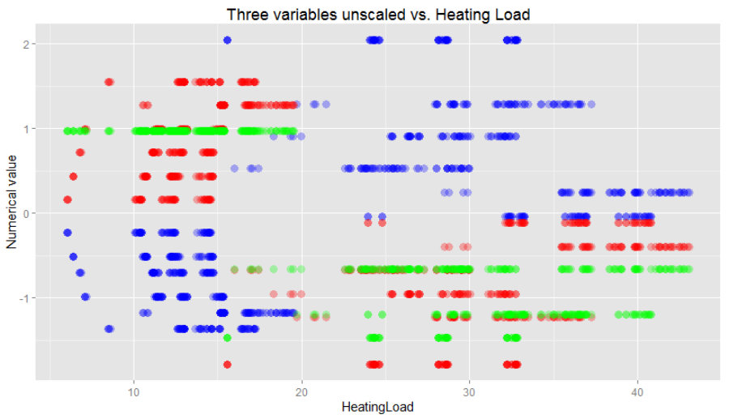
Scaled data for model construction
RelativeCompactness
SurfaceArea
RoofArea

Slide 25
Scaling
Normalize Data module
With R
With Python

